Slide 1

Lab4: Graph Matching
St. Petersburg College

Slide 2
Objective
Analyze motion using graphical representations. In particular, you will:
• Predict, sketch, and test position vs. time kinematics graphs
• Predict, sketch, and test velocity vs. time kinematics graphs

Slide 3
Introduction
One of the most effective methods of describing motion is to plot graphs of position, velocity, and acceleration vs. time. From such a graphical representation, it is possible to determine in what direction an object is going, how fast it is moving, how far it traveled, and whether it is speeding up or slowing down. In this experiment, you will use a Motion Detector to determine this information by plotting a real time graph of motion.

Slide 4

LabPro Interface
Logger Pro software will be used to collect data using the LabPro interface. For this lab, a motion detector will be attached to the LabPro. The Motion Detector measures the time it takes for a high frequency sound pulse to travel from the detector to an object and back.
Using this round-trip time and the speed of sound, you can determine the position of the object. Logger Pro will perform this calculation for you.
It can then use the change in position to calculate the object’s velocity and acceleration.
All of this information can be displayed either as a table or a graph.
A qualitative analysis of the graphs of motion will help you develop an understanding of the concepts of kinematics

Slide 5
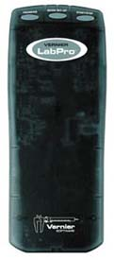
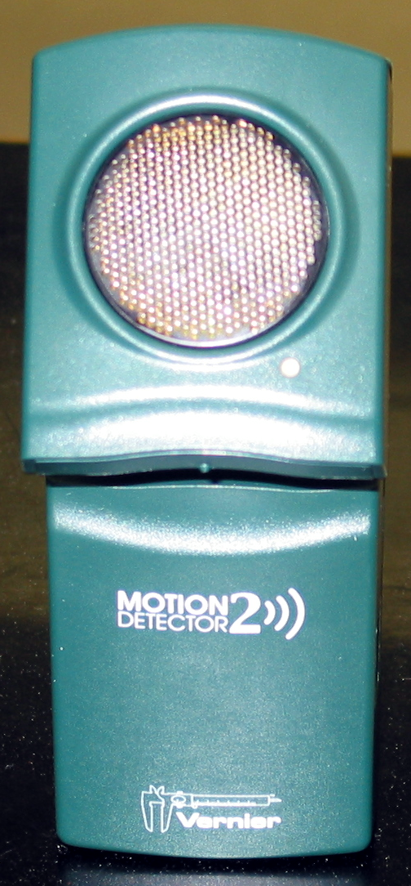
Apparatus
Computer with Logger Pro | Motion Detector
Masking Tape | Meter Stick
Board | Vernier LabPro with accessories

Slide 6
Procedure: Software
Look for Logger Pro on desktop and open.
→ file → open → physics with computer
Choose “Ø1b Graph Matching” for 1st attempt
Choose “Ø1d Graph Matching” for 2nd attempt
Click green button in top right to collect data.
Note: Motion can be described in terms of:
  Position (x)
  Velocity (v)
  Acceleration (a)
  Time (t)

Slide 7
Procedure
The motion detector works best within a certain range of distances
Investigate the range by moving in front of the detector.

Slide 8
Procedure Part I: Learning about the Motion Detector
1. Connect the Motion Detector to the DIG/SONIC 1 channel of the interface.
2. Place the Motion Detector so that it points toward an open space at least 4 m long. Use short strips of masking tape on the floor to mark the 1 m, 2 m, 3 m, and 4 m positions from the Motion Detector.
3. Experiment with the motion detector to determine how the position axis corresponds to the distance from the sensor. In each of the cases below explain how you determined your answer.
Note: Use Logger Pro to produce a graph of your motion when you walk away from or towards the motion detector. To do this, stand about 1 m from the Motion Detector and have your lab partner click . Start walking when you hear it begin to click.
(a) If you wish to increase the position reading on the graph, would you move toward or away from the sensor? Explain how you can tell.
(b) How close to the sensor can you be and still be accurately detected? Explain how you can tell. (0.2)
(c) How far away from the sensor can you be and still be accurately detected? Explain how you can tell.()

Slide 9
Procedure Part II: Learning about Motion Graphs
.
Position vs. Time Graph Matching
1. Open the experiment file “01b Graph Matching.” A position vs. time graph will appear.
2. Sketch the graph and describe how you would walk to produce this target graph.
3. To test your prediction, choose a starting position and stand at that point. Start data collection by clicking . When you hear the Motion Detector begin to click, walk in such a way that the graph of your motion matches the target graph on the computer screen.
4. If you were not successful, repeat the process until your motion closely matches the graph on the screen.
5. Repeat Procedure for each lab partner.
6. Print the best attempt of each group member (Graph 1), that is one graph per group member.

Slide 10

Procedure Part II: Learning about Motion Graphs
Velocity vs. Time Graph Matching
Open the experiment file “01d Graph Matching.” A velocity vs. time graph will appear.
Describe how you would walk to produce this target graph. This is a description of what you think (predict) needs to be done to match the graph.
To test your prediction, choose a starting position and stand at that point. Start data collection by clicking . When you hear the Motion Detector begin to click, walk in such a way that the graph of your motion matches the target graph on the computer screen. It will be more difficult to match the velocity graph than it was for the position graph. If you were not successful, repeat the process until your motion closely matches the graph on the screen
Repeat Procedure for each lab partner.
Print the best attempt of each group member (Graph #), that is one graph per group member
When done, please remove the masking tape strips from the floor

Slide 11
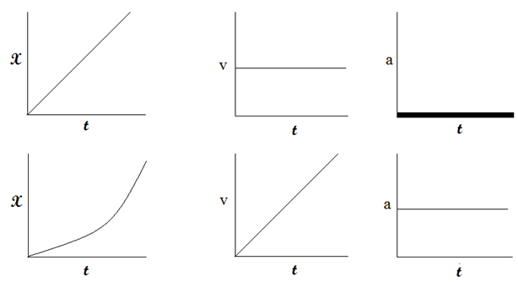
Graphical representation of motion:

